Slide 1



B.TECH PROJECT
END TERM
REVIEW
RTI Enhancement with CNN Post‑Processing
PRESENTED BY:
SUPERVISOR:
Jay Kumar (2022EE31781)
Rishit Jaiswal (2022EE31771)
Prof. Amartansh Dubey
Notes:
Good afternoon everyone. We are Jay Kumar and Rishit Jaiswal, and today we are presenting the End Term Review of our B.Tech Project."
"Our project is titled 'RTI Enhancement with CNN Post-Processing'."
"We have been working under the supervision of Prof. Amartansh Dubey at the Indian Institute of Technology Delhi."
"The core objective of our work is to improve the image quality of Radio Tomographic Imaging systems by integrating deep learning techniques with classical electromagnetic solvers.

Slide 2


03 | Project Overview
04 | Forward Simulation Code
05 | Forward Simulation Code - Results
06 | Inverse RTI Code
07 | Dataset Generation
08-09 | Dataset Generation - Results
10-11 | Training U-Net Model
12-13 | Training U-Net Model - Results
14 | Extending to a Moving Object
Contents
Notes:
Here is the roadmap for our presentation today
This is how we are going to proceed with the presentation today.

Slide 3
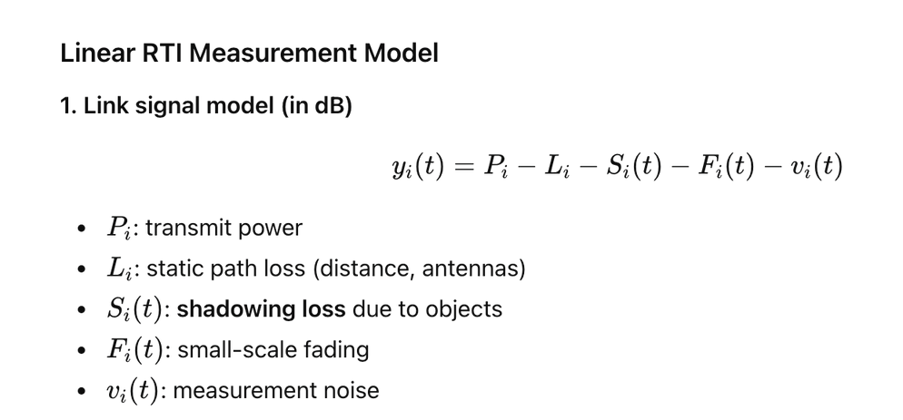
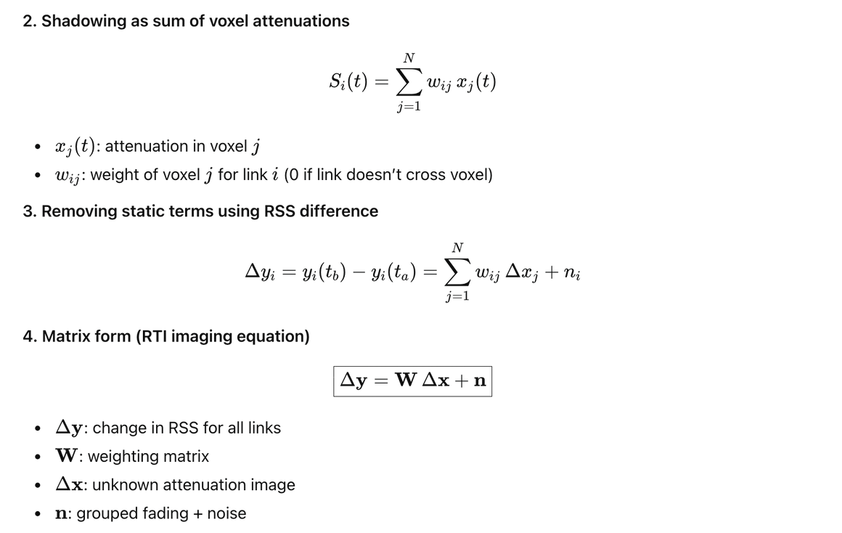
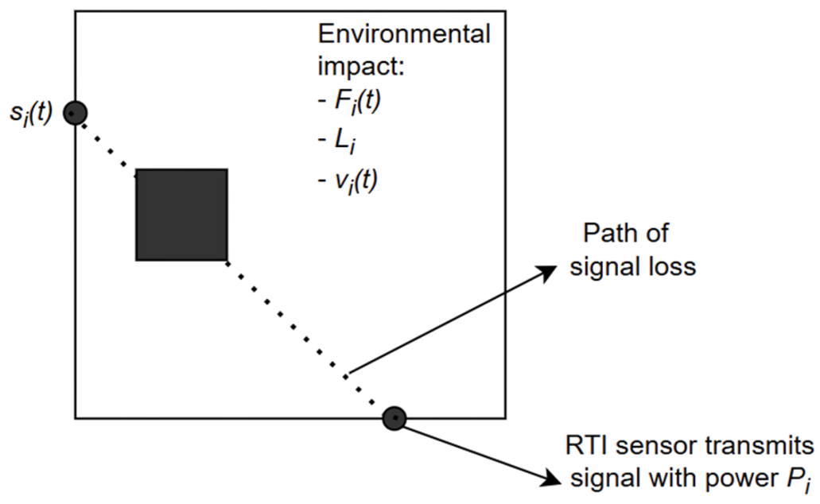
Project Overview
What is Radio Tomographic Imaging (RTI)?
  An imaging technique that maps how objects weaken (attenuate) signals inside a wireless network.
  It is device-free – the objects being imaged don’t need to carry any sensors or electronics.
  Goes beyond simple position tracking to also reveal an object’s shape, size, and attenuation pattern.
  Conceptually similar to a large-scale CT/MRI scanner, but using radio-frequency (RF) signals instead of X-rays.
Notes:
What is RTI?: "So, what is Radio Tomographic Imaging? It is a device-free imaging technique. Unlike traditional tracking where a user wears a tag, RTI maps how physical objects attenuate wireless signals (like WiFi) in a network."
Analogy: "Think of it conceptually like a CT scanner, but instead of using harmful X-rays, we use safe Radio-Frequency (RF) signals at 2.4 GHz."
Mathematical Model: "To implement this, we use a Linear RTI Measurement Model." 12"
The received signal strength (RSS), denoted as $y_i(t)$, is the transmit power minus various losses: static path loss $L_i$, shadowing loss $S_i(t)$ (which is what we care about), fading $F_i(t)$, and noise $v_i(t)$." 13"
We model the shadowing $S_i(t)$ as a weighted sum of attenuation in discrete pixels, or voxels."
The Imaging Equation: "By taking the difference in RSS measurements ($\Delta y$) over time, we eliminate static terms and arrive at the matrix form: $\Delta y = W \Delta x + n$." 15151515"
Here, $W$ is our weighting matrix based on the geometry, and $\Delta x$ is the image we are trying to solve for.

Slide 4
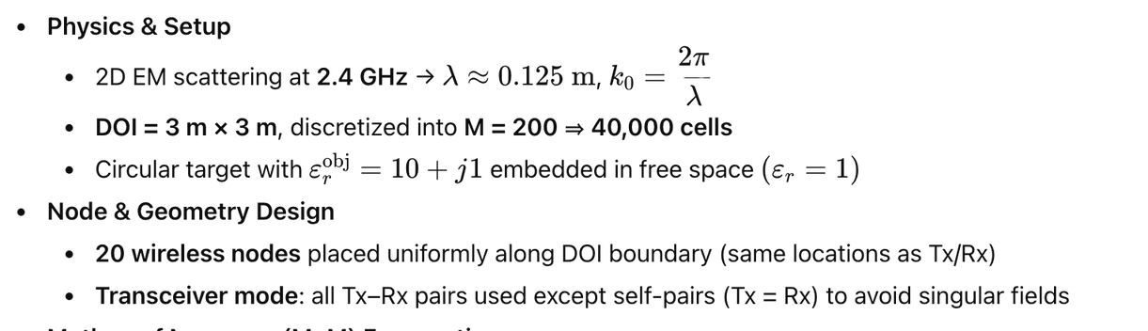
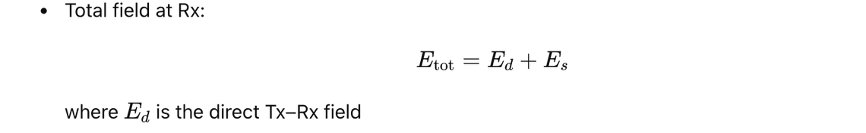
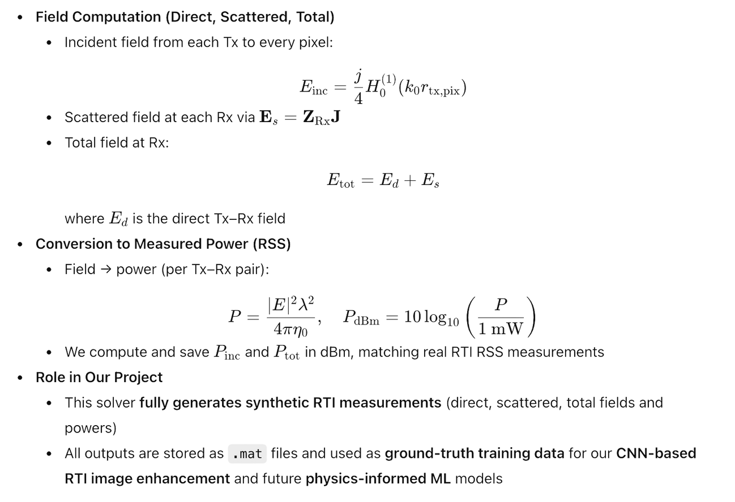
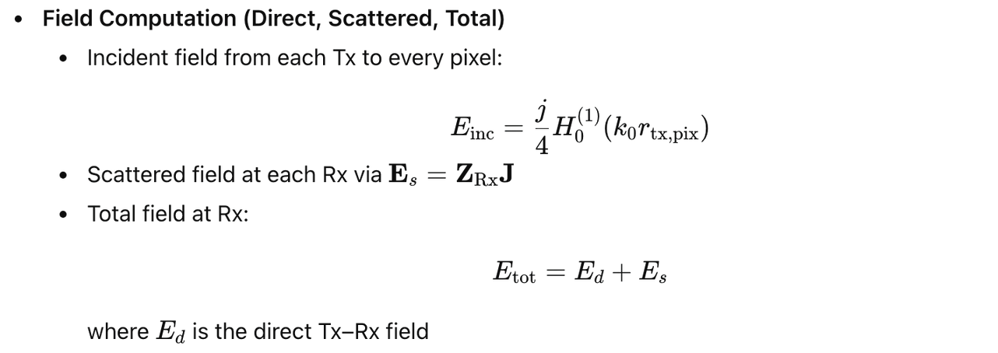
Forward Simulation Code
Notes:
Motivation: "To train a Neural Network, we needed a large amount of clean ground-truth data, which is difficult to capture manually. Therefore, we built a rigorous Forward Simulation Code."
Physics Setup: "We simulate 2D Electromagnetic scattering at 2.4 GHz ($\lambda \approx 0.125$ m). Our Domain of Interest (DOI) is a $3m \times 3m$ area discretized into 40,000 cells."
The Object: "We place dielectric objects with a relative permittivity of $\epsilon_r^{obj} = 10+j1$ into free space."
Field Computation: "We solve for the electric fields rigorously.
The Incident Field ($E_{inc}$) is calculated using Hankel functions ($H_0^{(1)}$)." 20"
The Total Field ($E_{tot}$) is the sum of the direct incident field and the scattered field produced by the object."
Output: "Finally, we convert these electric fields into Power (dBm) to match the RSS measurements used in real hardware setups. This solver provides our 'Ground Truth' data."
---------
Introduction to the Solver: "Moving on to our Forward Simulation Code. To train our Neural Network, we needed high-fidelity data that mimics real-world physics. We didn't want to rely on simple ray-tracing, so we implemented a rigorous 2D electromagnetic solver at 2.4 GHz."
Modeling the Transmitter (The Hankel Function): "Let's look at how we calculate the Incident Field (E
inc
​
).
In a 2D environment, we model our wireless nodes as infinite line sources perpendicular to the plane.
The solution to the wave equation for an outgoing cylindrical wave from a line source is given by the Hankel Function of the first kind, zeroth order, denoted here as H
0
(1)
​
.
Physically, this function describes how the wave amplitude decays and the phase shifts as the signal travels distance r from the transmitter (Tx) to any pixel in the grid. It forms the 'baseline' signal in empty space."
Calculating the Scattering (The Interaction): "When this incident wave hits our target object (which has a complex permittivity of 10+j1), it induces polarization currents inside the object's volume.
We discretize the domain into 40,000 small cells.
We then calculate the Scattered Field (E
s
​
) at the receiver. This is done by treating every small cell inside the object as a secondary source of radiation.
Mathematically, this is represented as E
s
​
=Z
Rx
​
J, where J is the induced current density and Z
Rx
​
is the impedance matrix linking the object pixels to the receivers."
The Total Field & RSS: "Finally, the receiver observes the Total Field (E
tot
​
), which is the complex superposition of the direct Incident field and the Scattered field.
This interference pattern is crucial—it captures the fading and diffraction effects that simple models miss.
We convert this complex electric field magnitude into Power in dBm to match the RSSI format output by commercial WiFi chips, ensuring our synthetic data is compatible with real hardware."
For Q&A /:
Why Hankel? "The Hankel function H
0
(1)
​
(kρ) is the Green’s Function for the 2D Helmholtz equation in free space. Since we are solving a scattering problem, we need the Green's function to propagate the field from the source to the scatterer, and from the scatterer to the receiver. H
0
(1)
​
represents an outgoing traveling wave, satisfying the Sommerfeld radiation condition (meaning waves travel away from the source and don't reflect back from infinity)."
Is this Method of Moments? "Yes, essentially. The equation E
s
​
=Z
Rx
​
J implies we are solving an integral equation where the domain is discretized (pulse basis functions) and we are summing the contributions of induced currents (point matching/testing). This is a standard 2D Method of Moments formulation with Born approximation or full inversion depending on how we solve for J."

Slide 5
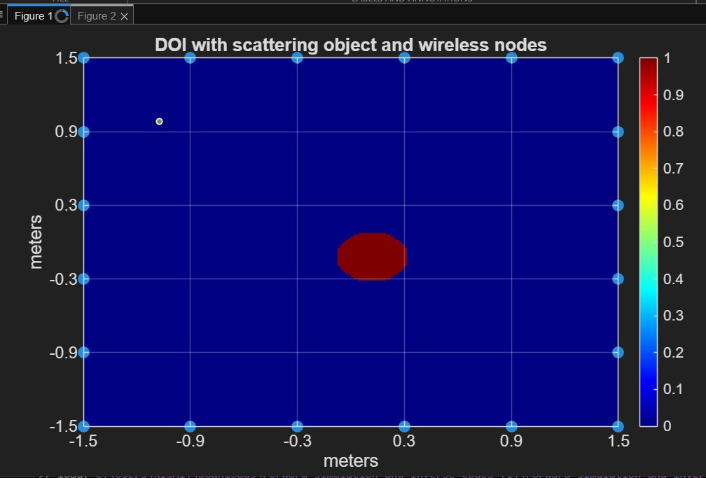
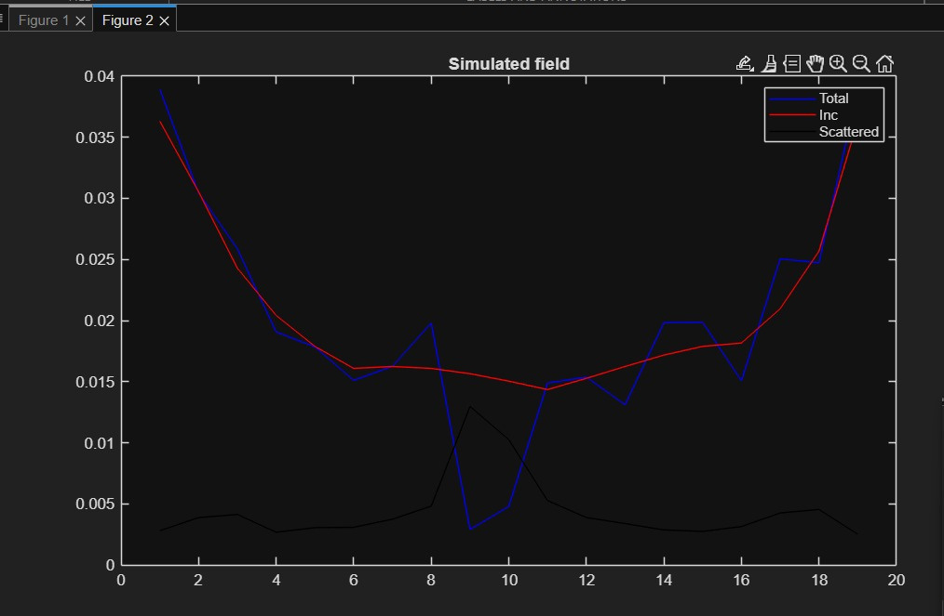
Forward Simulation Code - Results
Notes:
Speaker Notes:"Here we visualize the output of our forward solver." 23
Left Image: "You can see the $3m \times 3m$ Domain of Interest. The red circle represents the scattering object, and the cyan dots along the boundary are our 20 wireless transceiver nodes." 24
Right Image: "This plot shows the signal strength across the sensors.
The Red line is the Incident field (empty room).
The Blue line is the Total field (with object).
The deep dips in the blue line correspond to the 'shadowing' effect caused by the object blocking the link. This difference is exactly the data used to reconstruct the image

Slide 6
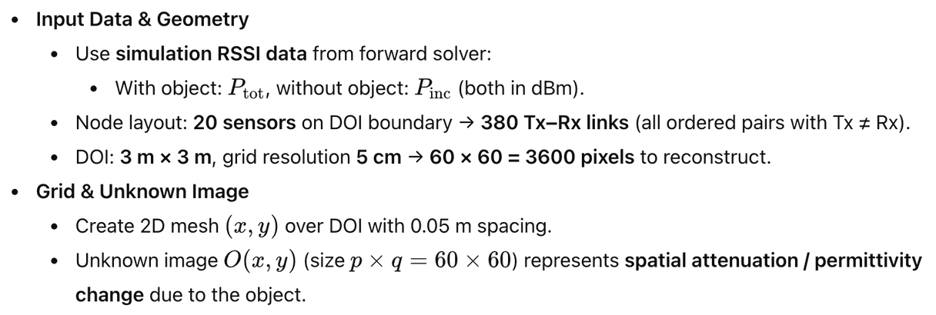
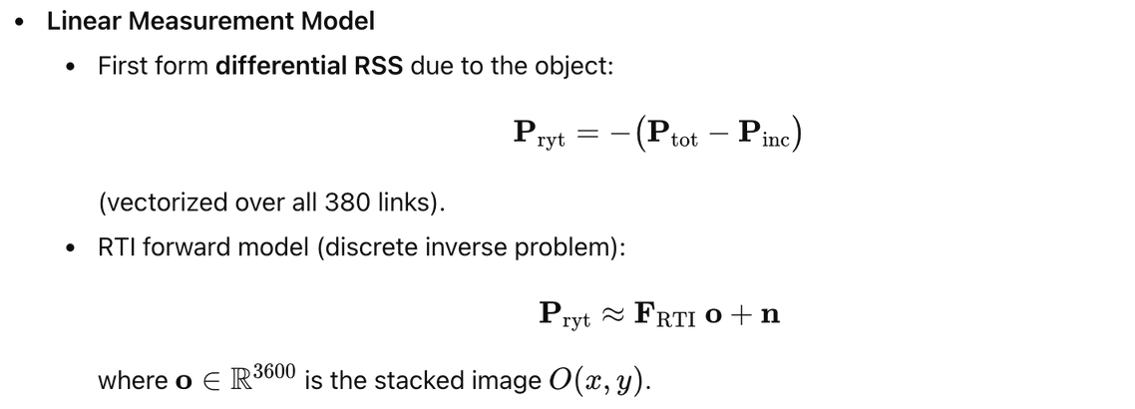
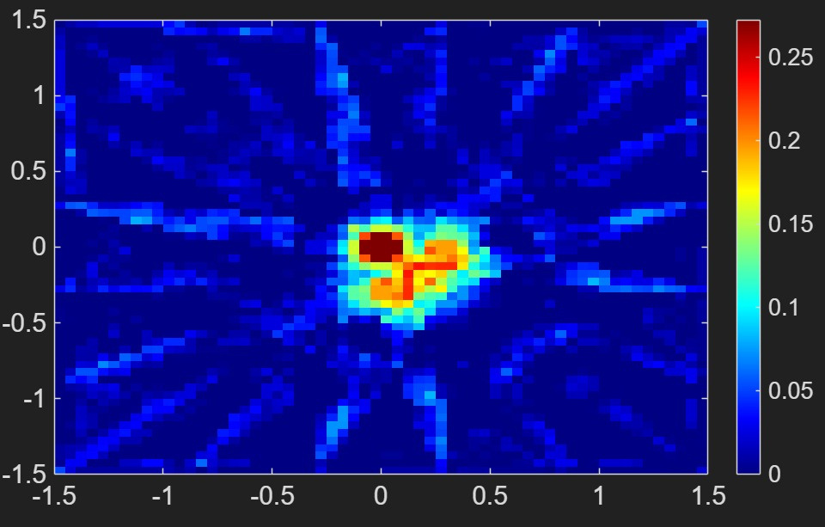
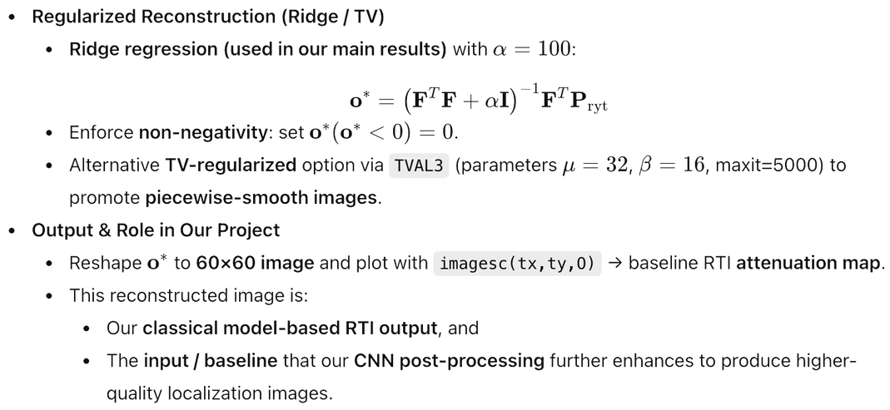
Inverse RTI Code
Fig: Inverse RTI Code output
Notes:
"Once we have the simulated RSS data, we need to reconstruct the image. This is the 'Inverse' problem." 26
Geometry: "We use the same 20-node layout, resulting in 380 unique communication links ($20 \times 19$)." 27
Reconstruction Grid: "We reconstruct the image on a coarser $60 \times 60$ pixel grid ($5cm$ resolution)." 28
The Algorithm: "We solve the linear equation $P_{ryt} \approx F_{RTI}o$." 29"
Because this problem is ill-posed, we use Ridge Regression with a regularization parameter $\alpha=100$." 30"
The solution, $o^* = (F^T F + \alpha I)^{-1} F^T P_{ryt}$, gives us the baseline attenuation map." 31
The image you see on the bottom left is the output of this classical method. It is blurry and noisy. This specific image serves as the input to our CNN, which we task with cleaning it up."
--------
Introduction to the Inverse Problem:"Now that we have the simulated signal data, we face the Inverse Problem: How do we turn these signal measurements back into an image of the object?We set up a grid of $60 \times 60$ pixels, meaning we have 3,600 unknown values ($o$) to solve for1111. However, we only have 380 measurements (links) from our 20 sensors2. This makes the problem mathematically 'ill-posed' or underdetermined."
Step 1: The Measurement Vector ($P_{ryt}$)"First, we construct our measurement vector, which we call $P_{ryt}$.The equation is:$$P_{ryt} = -(P_{tot} - P_{inc})$$$P_{tot}$ is the received power with the object, and $P_{inc}$ is the power in empty space3.
Why the negative sign? Because an object blocks signals, $P_{tot}$ is usually lower than $P_{inc}$, making the difference negative. We multiply by $-1$ to convert this 'loss' into a positive 'attenuation' value that we can map4.
This gives us a column vector $\Delta y$ of size $380 \times 1$5."
Step 2: The Imaging Equation"We model the relationship between the measurements and the image linearly:$$P_{ryt} \approx F_{RTI} o + n$$$o$:
This is our unknown image, flattened into a vector of length 3,600.
$F_{RTI}$: This is the Weighting Matrix (or Sensitivity Matrix). It describes which pixels affect which link. If a link physically passes through a specific pixel, that entry in $F$ is non-zero.
$n$: This represents noise and modeling errors7."
Step 3: The Solution (Ridge Regression)"Because we have fewer equations (380) than unknowns (3,600), we cannot simply invert matrix $F$. The system is unstable.To solve this, we use Ridge Regression8.
The closed-form solution we implemented is:$$o^* = (F^T F + \alpha I)^{-1} F^T P_{ryt}$$
Let me break this down9:
$F^T P_{ryt}$: This is a 'back-projection' step. It smears the measurement data back across the links.
$F^T F$: This is the Gram matrix, representing the correlation between different pixels.
$+ \alpha I$: This is the critical regularization term. By adding a small value ($\alpha=100$) to the diagonal, we make the matrix invertible and smooth out the noise10. Without this, the image would be pure static."
Step 4: Physical Constraints"Finally, physics dictates that an object cannot have 'negative' opacity.So, we apply a projection constraint:$$o^*(o^* < 0) = 0$$
Any pixel calculated as negative is forced to zero11.
The result is the image you see on the bottom right—a blurry but localized estimation of the object. This blurry image ($X_{hat}$) becomes the input for our Neural Network
Q: Why did you choose Ridge Regression over TV (Total Variation) regularization?
A: "We actually explored TV regularization using the TVAL3 algorithm, which is excellent for piecewise-smooth images13. However, TV solvers are iterative and computationally slower. Ridge regression offers a closed-form solution14, which is much faster to compute. Since our goal was to generate thousands of samples for training a deep learning model, the speed of Ridge regression was preferred. We rely on the U-Net to recover the sharp edges that Ridge regression smooths out."
Q: What is the dimensionality of $F_{RTI}$?
A: "$F_{RTI}$ is a $380 \times 3600$ matrix. It maps the 3,600 image pixels to the 380 sensor links

Slide 7
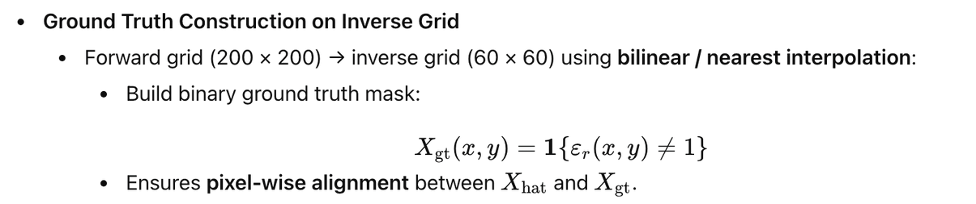
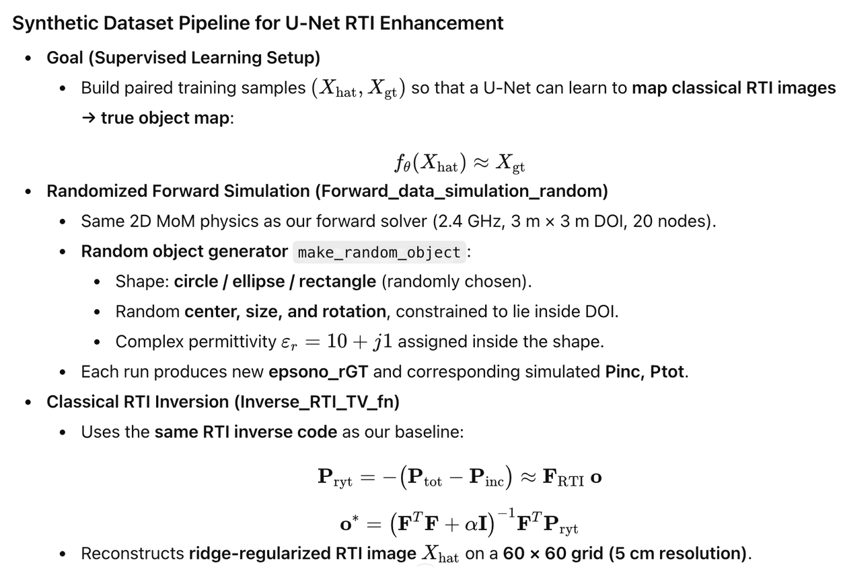
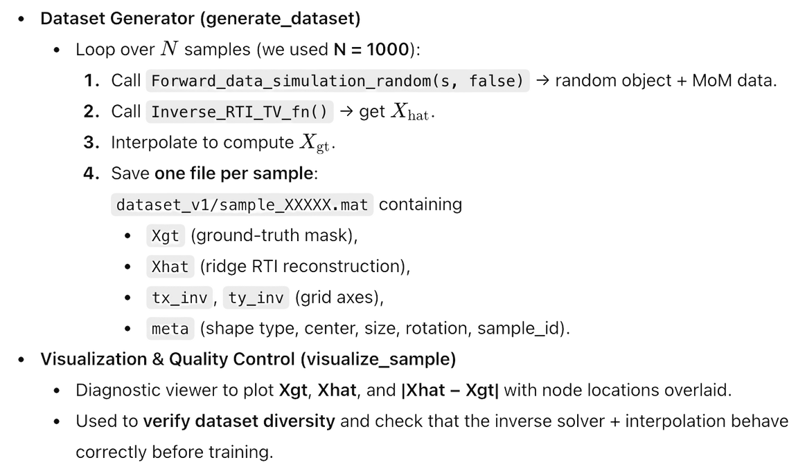
Dataset Generation
Notes:
Deep learning requires massive amounts of paired data. We automated this using a custom pipeline." 33
Randomization: "We wrote a script to generate random objects—circles, ellipses, and rectangles— with random sizes, centers, and rotations."
The Loop: "For each random sample (we generated 1,000 total):
We run the Forward Simulation to get accurate physics-based RSS data." 35"
We run the Inverse Solver to get the noisy 'Ridge' reconstruction ($X_{hat}$)." 36"
We generate a binary Ground Truth mask ($X_{gt}$) that aligns perfectly with the grid." 37
Result: "We save these pairs ($X_{hat}, X_{gt}$) to train our U-Net to map the noisy input to the clean ground truth.
We have mentioned the step by step process we followed in this slide.

Slide 8
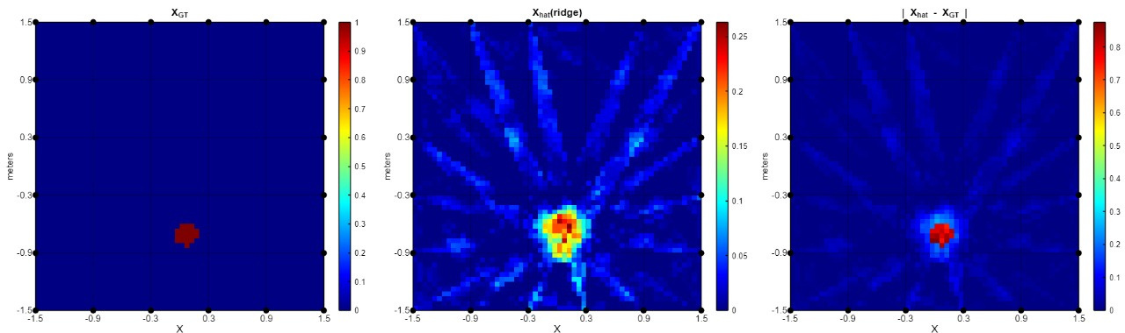
Dataset Generation - Results
Notes:
:"This slide visualizes a single sample from our generated dataset to show you the quality of the data." 39
Left ($X_{GT}$): "This is the Ground Truth. A clean, sharp circular object." 40
Middle ($X_{hat}$): "This is the Ridge Reconstruction—the input to our network. Notice the 'starburst' artifacts and the noise throughout the domain. This is typical of linear RTI inversions." 41
Right ($|X_{hat} - X_{GT}|$): "This shows the error. The goal of our Neural Network is to minimize this difference." 42"
We generated these plots for every sample to verify that the interpolation and physics were correct before training."

Slide 9
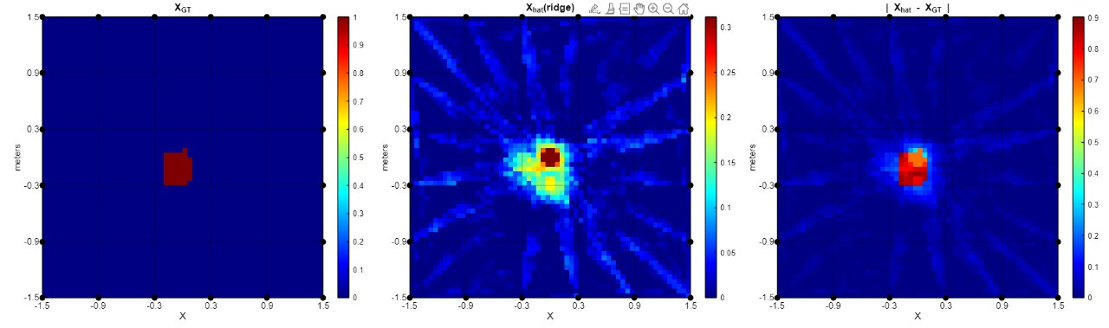
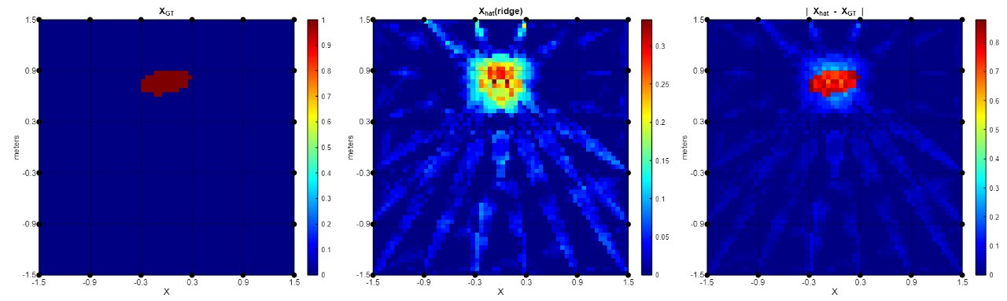
Notes:
Here are more examples showing the diversity of our dataset."
"We included not just circles, but also ellipse and rectangles (as seen in the top row) and different orientations (as seen in the bottom row)."
"You can clearly see that the classical Ridge method (middle column) always struggles with sharp edges and produces significant background noise."
"By training on these diverse shapes, we ensure our U-Net doesn't just memorize 'circles', but actually learns to de-noise and localize attenuation patterns

Slide 10
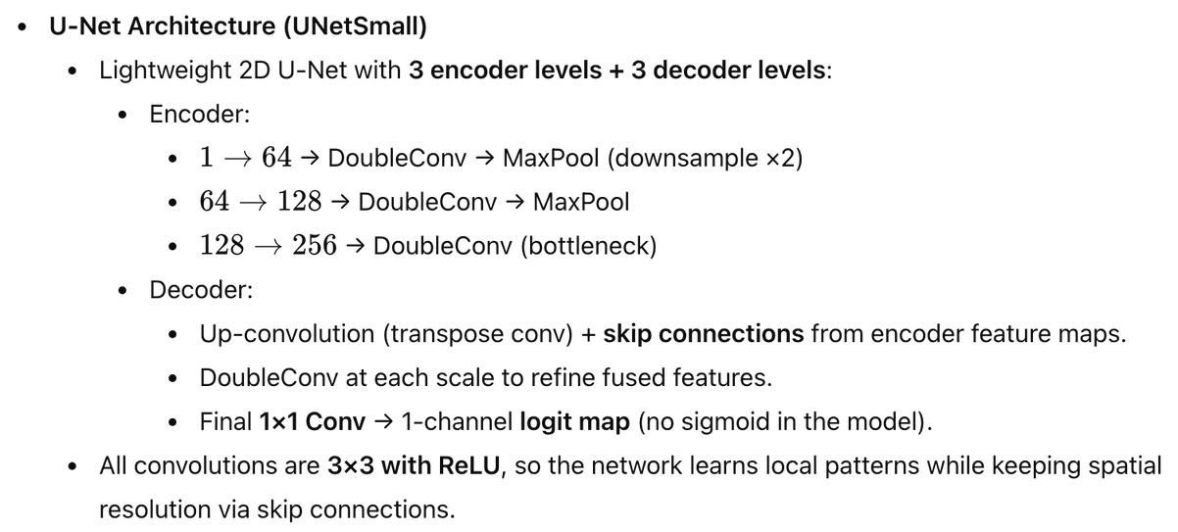
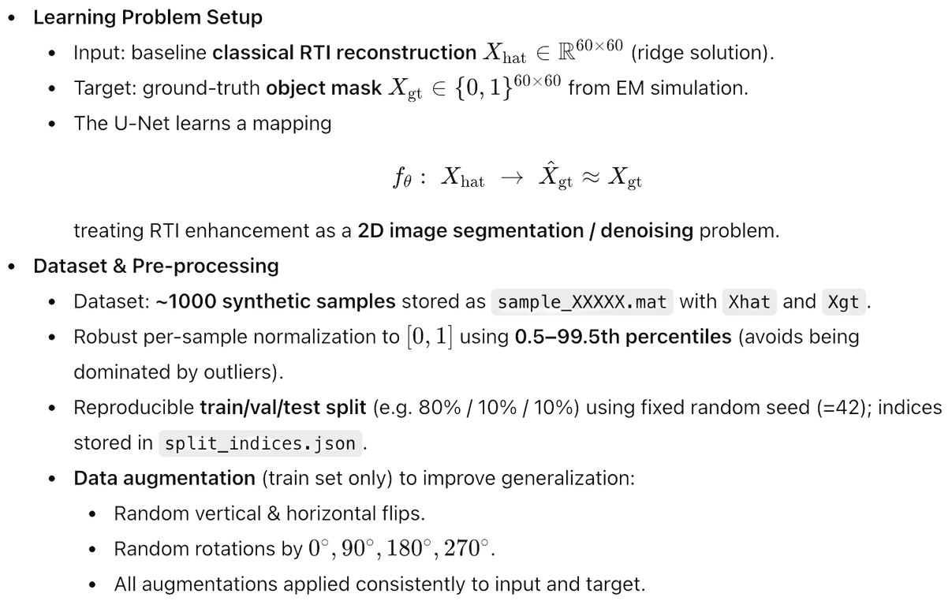
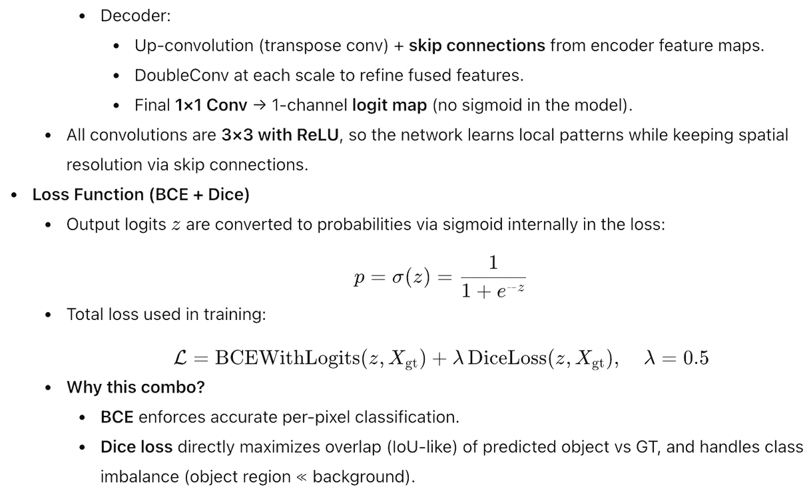
Training U-Net Model
Notes:
Intro
“Here I’ll explain how we train our U-Net to clean up RTI reconstructions.”
1. Problem Setup
“Input is the classical RTI image Xhat (60×60, real-valued, blurry).”
“Target is a binary mask XGT
​
(0/1), showing where the object actually is.”
“So the U-Net learns a mapping ftheta: Xhat->Xpred
​
, treating this as a 2D segmentation / denoising task.”
2. Dataset & Pre-processing
“We generate about 1000 synthetic samples, each storing Xhat and Xgt.”
“For each sample, we normalize the RTI image to [0,1] using the 0.5th–99.5th percentiles to remove outliers.”
“We use a fixed 80/10/10 train–val–test split, saved in split_indices.json for reproducibility.”
“On the training set, we apply flips and 90° rotations to both input and target to increase data and improve generalization.”
3. U-Net Architecture (UNetSmall)
“We use a lightweight U-Net with 3 encoder and 3 decoder levels.”
2. Encoder (downward path)
In U-Net for images:
Input: 60×60 image.
The encoder:
Applies conv layers → learns local patterns (edges, blobs, shapes).
Uses max-pooling / strided conv → halves height and width each time.
As we go down:
Spatial size ↓ (60×60 → 30×30 → 15×15 …)
Number of channels ↑ (1 → 64 → 128 → 256 …)
So the encoder turns the big image into a small but rich feature representation that captures “what is where” in a compressed form.
3. Decoder (upward path)
Now we want an output image (same size as input), e.g. a segmentation mask.
The decoder:
Uses upsampling / transpose conv to increase size
(15×15 → 30×30 → 60×60).
Combines this with encoder features (skip connections in U-Net).
Applies conv layers to refine.
As we go up:
Spatial size ↑,
Channels ↓,
until we get back to a 60×60, 1-channel output (probability at each pixel).
4. Loss: BCE + Dice
“The network outputs logits
𝑧
z; we apply a sigmoid inside the loss to get probabilities.”
“Total loss = BCEWithLogits + 0.5 × Dice loss.”
“BCE gives accurate per-pixel classification, and Dice focuses on overlap and handles the strong class imbalance between object and background.”
“Together, this setup lets the U-Net turn noisy RTI reconstructions into clean, well-localized object masks.”

Slide 11
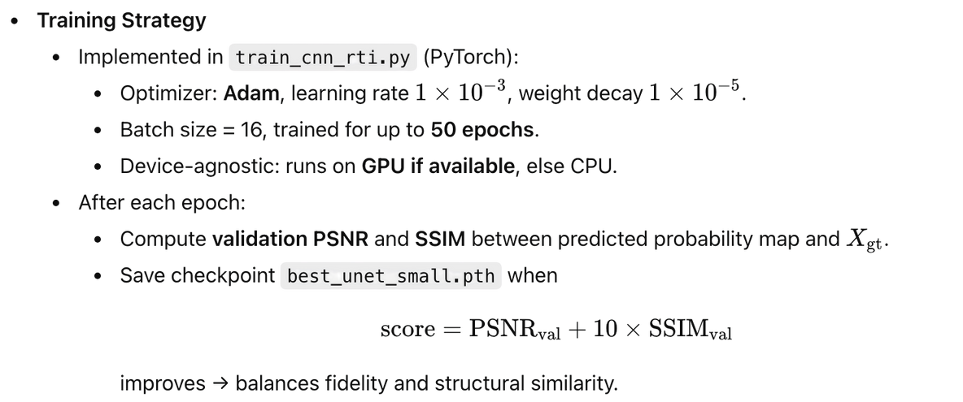
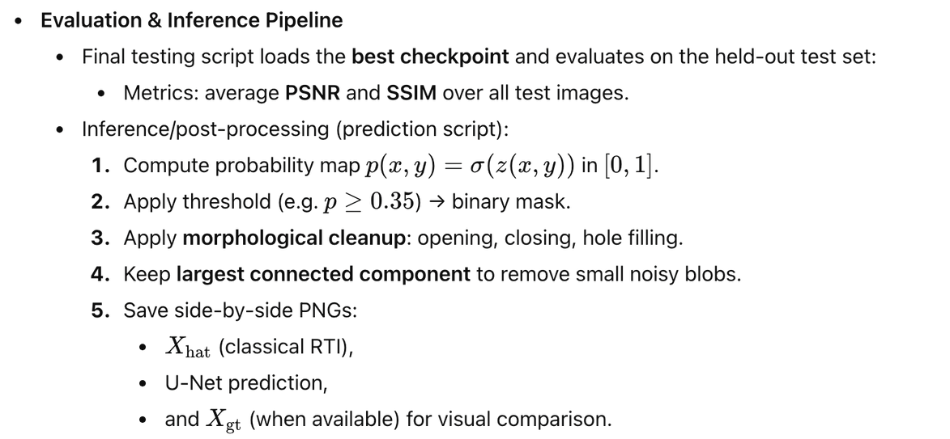

Training U-Net Model
Notes:
Training Strategy (left)
“We train the U-Net in PyTorch using the Adam optimizer with learning rate 10^-3
and a small weight decay 10^^-5
to avoid overfitting.
We use batch size 16, train for up to 50 epochs, and the script automatically uses GPU if available, otherwise CPU.
After every epoch we evaluate on a validation set and compute PSNR and SSIM between the prediction and the ground-truth mask.
PSNR measures pixel-wise error; SSIM measures how similar the structure and shape are.
To pick the best model we define a combined validation score:
Scaling SSIM by 10 puts it on the same scale as PSNR, so this single score balances fidelity and structural similarity.
Whenever this score improves, we save a checkpoint best_unet_small.pth.
Our best model reaches a score of about 35.76, corresponding to PSNR ≈ 26.8 dB and SSIM ≈ 0.886, which indicates reasonably accurate and structurally faithful reconstructions.”
“For testing, we load this best checkpoint and evaluate it on the held-out test set, again reporting average PSNR and SSIM.
For each test image the pipeline is:
Run the U-Net to get a probability map via sigmoid.
Threshold it (e.g.
p≥0.35) to get a binary mask.
Apply simple morphological cleanup—opening, closing, hole filling.
Keep only the largest connected component to remove tiny noisy blobs.
Save side-by-side images: classical RTI xhat
​
U-Net prediction, and ground truth xgt
when available.
“This gives us both quantitative metrics and clear visual evidence that the U-Net improves the RTI reconstructions.”

Slide 12
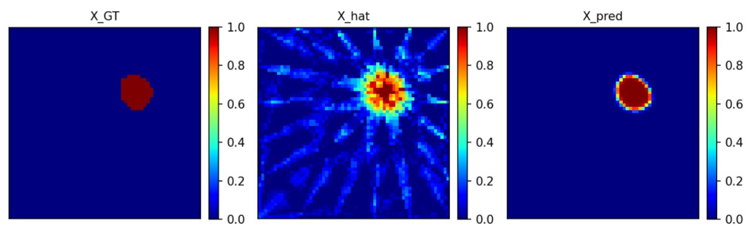
Training U-Net Model - Results

Slide 13
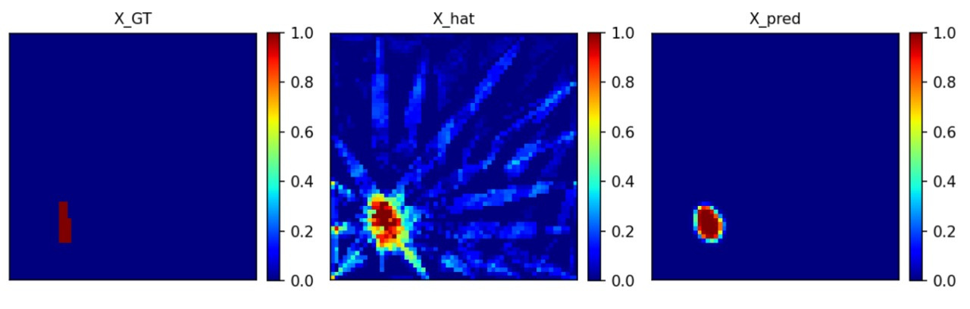
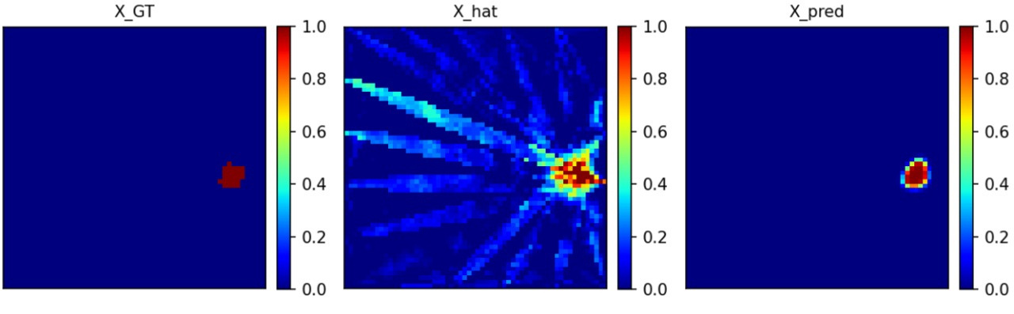

Slide 14
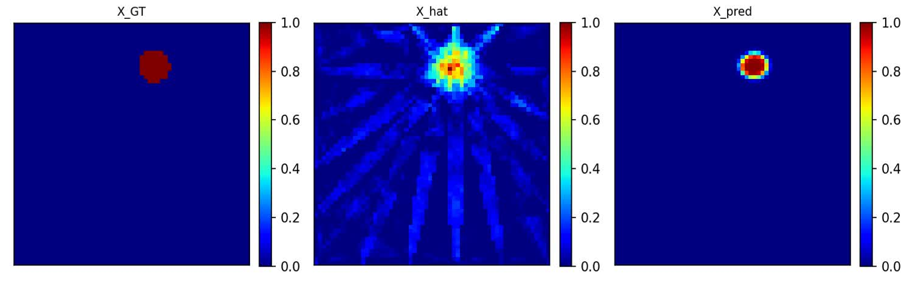
Extending to a Moving Object
  We used Simulation Team’s code for simulating an object moving in a circular trajectory.
  Added per-frame export in MATLAB (inverse RTI script): After reconstructing the sequence Otime(:, :, t), we export each frame as a .mat containing X̂ (and X_GT mask if trajectory is available), with per-frame [0,1] normalization.
  Created a folder that loads all frame_*.mat files, runs our trained U-Net (base=64) to produce X_pred, and saves side-by-side panels (X_GT | X̂ | X_pred).
Notes:
Extending to a Moving Object – Speaker Notes
“Till now we only showed static objects. Next, we tested our pipeline on a moving object.”
“The Simulation Team gave us MATLAB code that simulates a person moving on a circular path. For every time step we reconstruct an RTI image and save it as frame_XXXX.mat with xhat
and, when available, the true mask xgt
, all normalized to [0,1].”
“In Python we wrote a script that loads all these frame files, runs our trained U-Net on each one, and saves side-by-side images: ground truth, classical RTI, and U-Net output.”
“At the bottom you can see one example frame:
left is the true position, middle is the noisy RTI reconstruction with strong streaks, and right is the U-Net result, which gives a clean, well-localized blob.
So the same model also works frame-by-frame for a moving target.”

Slide 15
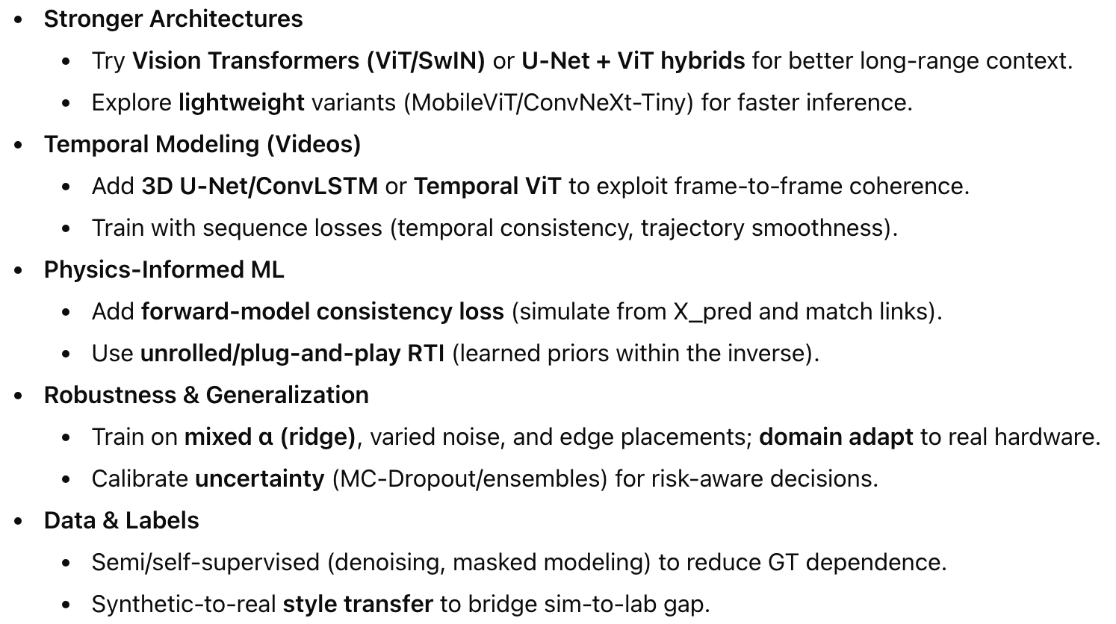
Future Scope
Notes:
Future Scope – Speaker Notes
“Going ahead, we want to try stronger architectures, like Vision Transformers or U-Net + ViT hybrids, and also lighter models so that inference is faster.”
“Second, instead of treating each frame independently, we want to do temporal modeling using 3D U-Net or ConvLSTM so the network uses frame-to-frame continuity of the moving person.”
“Third, we want to make the model physics-aware by adding a loss that checks: if we simulate RSS from our predicted image, it should match the measured links. This is a physics-informed or unrolled RTI approach.”
“We also want to improve robustness, by training with different noise levels, different ridge parameters and layouts, and adapting the model to real hardware. We can also calibrate uncertainty, so the system knows when it is less confident.”
“Finally, on the data side, we’d like to use semi- or self-supervised methods to reduce reliance on exact ground truth, and apply synthetic-to-real style transfer so that models trained on simulation work better in the lab.”

Slide 16

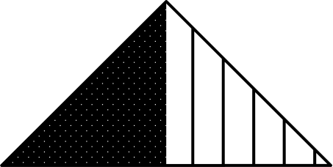

Thank you

